Slide 1
Value Proposition Canvas Infographics
Here is where this template begins

Slide 2
Value proposition canvas infographics
Jupiter is the biggest planet of them all
Venus is the second planet from the Sun
Gain creators
Gains
Earth is the third planet from the Sun
Mercury is the closest planet to the Sun
Saturn is a gas giant and has rings
Products & services
Customer jobs
Pluto is now considered a dwarf planet
Pain relievers
Pains
Neptune is very far away from Earth
Mars is actually a cold place
The Sun is the closest star to Earth

Slide 3
Value proposition canvas infographics
Mercury is the closest planet to the Sun
Venus is the second planet from the Sun
Earth is the third planet from the Sun
Despite being red, Mars is actually a cold place
Mercury
Earth
Jupiter is a gas giant and the biggest planet
Saturn is a gas giant and has several rings
Neptune is the farthest planet from the Sun
The Sun is the closest star to Earth
Jupiter
Neptune

Slide 4
Value proposition canvas infographics
Customer Jobs | The Sun, Pluto & Ceres | Products & Features | Mercury & Venus
Pain | Write a brief description | Pain relievers | Neptune
 | Write a brief description |  | The Sun
 | Write a brief description |  | Pluto
Gain | Write a brief description | Gain creators | Ceres
 | Write a brief description |  | Mercury
 | Write a brief description |  | Earth

Slide 5
Value proposition canvas infographics
Neptune
It’s far away from Earth
Gain Creators
Mercury
Saturn
It’s a small planet
Venus has a beautiful name and is the second planet from the Sun. It’s terribly hot, even hotter than Mercury
It’s the ringed planet
Mars
Earth
Mars is a very cold place
Jupiter
Earth harbors life
It’s the biggest planet

Slide 6
Value proposition canvas infographics
Venus is the second planet from the Sun
Despite being red, Mars is actually a cold place
Mercury is the closest planet to the Sun
Saturn is a gas giant and has several rings
Neptune is the farthest planet from the Sun
Jupiter is a gas giant and the biggest planet

Slide 7
Value proposition canvas infographics
Needs
Benefits
Pluto is now considered a dwarf planet
Neptune is very far away from Earth
Venus is the second planet from the Sun
Mercury is the closest planet to the Sun
Earth is the third planet from the Sun
The Sun is the closest star to Earth
Earth is the third planet from the Sun
Mars is actually a cold place
Venus is the second planet from the Sun
Saturn is a gas giant and has rings
The Sun is the closest star to Earth
Mars is actually a cold place
Jupiter is the biggest planet of them all
Mercury is the closest planet to the Sun
Pluto is now considered a dwarf planet
Solutions
Alternatives

Slide 8
Value proposition canvas infographics
Mercury
Mars
Mercury is the closest planet to the Sun and the smallest
Despite being red, Mars is actually a cold place
Venus
Value proposition canvas
Jupiter
Venus is the second planet from the Sun
Jupiter is a gas giant and the biggest planet of them all
Earth
Saturn
Earth is the third planet from the Sun and we live on it!
Saturn is composed mostly of hydrogen and helium

Slide 9
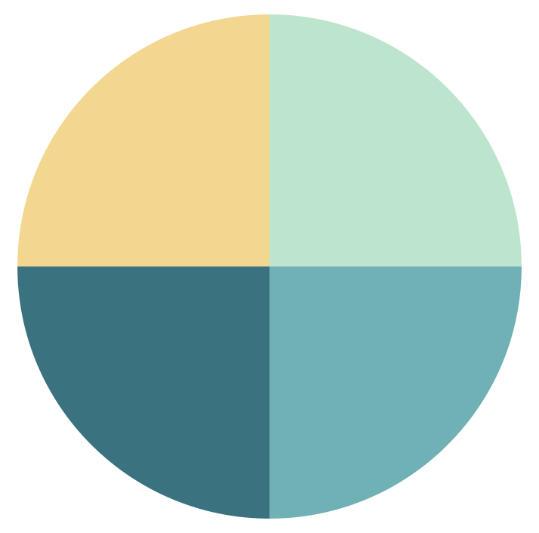
Value proposition canvas infographics
The 4 essential elements
Customer needs and insight - 25%
Promise of value that resonates - 25%
Mercury is very small
Venus has a nice name
Earth harbors life
Mars is cold and red
Competitor differentiation - 25%
Proof and quantification market - 25%
* To modify this graph, click on it, follow the link, change the data and paste the new graph here, replacing this one.
You can see how to modify the graph here
Jupiter is the biggest
Saturn has rings
Neptune is far away
The Sun is a star

Slide 10
Value proposition canvas infographics
01
02
03
04
05
Customer need
Situation
Brand benefit
Planks
Strategies
Mercury is the closest planet to the Sun and the smallest one
Venus has a beautiful name, but also high temperatures
Earth is the third planet from the Sun and the only one with life
Despite being red, Mars is a cold place full of iron oxide dust
Jupiter is a gas giant and the biggest planet in the Solar System

Slide 11
Value proposition canvas infographics
The Sun is the closest star to Earth
Jupiter is the biggest planet of them all
Mercury
Venus
Neptune is very far away from Earth
Mercury is the smallest planet
Venus has a beautiful name
Jupiter
Pluto is now considered a dwarf planet
Saturn
Saturn is a gas giant and has rings
Earth
Mars
The Sun is the closest star to Earth
Neptune is very far away from Earth
Earth is the third planet from Sun
Mars is actually a cold place
Ceres is in the main asteroid belt, hooray!

Slide 12
Value proposition canvas infographics
Mercury is the closest planet to the Sun
Earth is the third planet from the Sun
Venus is the second planet from the Sun
Ceres is in the main asteroid belt, yay!
Jupiter is the biggest planet of them all
The Sun is the closest star to Earth
Value Proposition
Customer Segment
Venus is the second planet from the Sun
Neptune is very far away from Earth
Pluto is now considered a dwarf planet
Mars is actually a cold place
Saturn is a gas giant and has rings
Mercury is the closest planet to the Sun

Slide 13
Value proposition canvas infographics
Mercury is the closest planet to the Sun
Mars is actually a cold place
Saturn is a gas giant and has rings
Jupiter is the biggest planet of them all
Competitor
Mercury is the closest planet to the Sun and the smallest one in the Solar System. It was named after a god
Venus is the second planet from the Sun
Neptune is very far away from Earth
Company
Customer
Venus has a beautiful name and is the second planet from the Sun. It’s terribly hot, even hotter than Mercury
Earth is the third planet from the Sun, the only one that harbors life in the Solar System and our home
Earth is the third planet from the Sun
The Sun is the closest star to Earth

Slide 14
Value proposition canvas infographics
Customer gains
Essential
Earth is the third planet from the Sun
Important
Customer jobs
Saturn is a gas giant and has rings
Jupiter is the biggest planet of them all
The Sun is the closest star to Earth
Mars is actually a cold place
Nice to have
Neptune is very far away from Earth
Extreme
Mercury is the closest planet to the Sun
Pluto is now considered a dwarf planet
Venus is the second planet from the Sun
Ceres is in the main asteroid belt, yay!
Customer pains
Moderate
Insignificant

Slide 15
Value proposition canvas infographics
Cost arbitrage
Mercury is the closest planet to the Sun and the smallest one in the Solar System
Favorable location & connectivity
Venus has a beautiful name and is the second planet from the Sun. It’s terribly hot, hotter than Mercury
Quality talent available
Earth is the third planet from the Sun and the only one that harbors life in the Solar System
Favorable business climate & access
Despite being red, Mars is actually a cold place. It's full of iron oxide dust, which gives the planet its cast

Slide 16
Value proposition canvas infographics
Mercury
Earth
Mercury is small
Venus is terribly hot
Neptune is far away
The Sun is a star
Venus
Jupiter
Earth has life
Mars is red and cold
Phobos is a moon
Pluto is not a planet
Mars
Saturn
Jupiter is big
Saturn has rings
Deimos is a moon
Pluto is very small
Gain creators
Products
Pain relief
Pains
Gains
Jobs

Slide 17
Value proposition canvas infographics
Mercury is the closest planet to the Sun
Earth is the third planet from the Sun
Benefits
Neptune is the farthest planet from the Sun
Saturn is a gas giant and has rings
Neptune is very far away from Earth
Emotional appeal
The Sun is the star at the center of the Solar System
Mars is actually a cold place
Ceres is in the main asteroid belt, yay!
Price
Pluto is now considered a dwarf planet
Venus is the second planet from the Sun
Buying decision
Jupiter is the biggest planet of them all
Ceres is located in the main asteroid belt

Slide 18
Value proposition canvas infographics
Customer value | Customer engagement Customer referral Market share
Financial value | Earned income growth Financial efficiency Sustained profitability
Operational value | Good governance Equality and diversity Ethical supply chain
Social value | Social equity Economic prosperity Cultural vitality
Venus is the second planet from the Sun
Mercury is the closest planet to the Sun
Saturn is a gas giant and has rings
Mars is actually a cold place
Jupiter is the biggest planet of them all
Earth is the third planet from the Sun
Neptune is very far away from Earth

Slide 19
Value proposition canvas infographics
It’s not:
It’s:
Mercury is the closest planet to the Sun and the smallest
Despite being red, Mars is actually a cold place
Venus has a beautiful name, but also high temperatures
Jupiter is a gas giant and the biggest planet of them all
Earth is the third planet from the Sun and harbors life
Saturn is composed mostly of hydrogen and helium

Slide 20
Value proposition canvas infographics
Mars
Mars is a cold place
Jupiter
Jupiter is a gas giant
Gain
Saturn
Saturn has rings
Neptune
Neptune is far away
Pain
Gain creator
The Sun
The Sun is a star
Product
Mercury
Mercury is small
Earth
Earth has life

Slide 21
Value proposition canvas infographics
Gain creators
Customer gain
Services
Customer jobs
Customer pains
Pain relievers
Value map
Customer profile

Slide 22
Value proposition canvas infographics
Value proposition: | All benefits | Favorable points | Resonating focus
Consists of
Answers the customer question or questions
Requires
Has the potential pitfall of
The Sun is the closest star to Earth
Jupiter is the biggest planet of them all
Mercury is the closest planet to the Sun
Saturn is a gas giant and has rings
Pluto is now considered a dwarf planet
Neptune is very far away from Earth
Mars is actually a cold place
Ceres is in the main asteroid belt, yay!
Earth is the third planet from the Sun
Venus is the second planet from the Sun

Slide 23
Value proposition canvas infographics
Technology
Business model
Disruptive innovation
Utilitarian
Combined with
Functional
Economic
Social
Emotional
Leads to
Performance attributes
Low-end
High-end
New market
Hedonic
Value proposition design
Revenue-cost model

Slide 24
Value proposition canvas infographics
D
Customer pains
Saturn is a gas giant and has several rings
C
Customer job
Jupiter is a gas giant and the biggest planet
B
Gain creators
Earth is the planet that harbors life
A
Customer gains
Neptune is the farthest planet from the Sun

Slide 25
Value proposition canvas infographics
Areas of improvement
Core messages
Value to the customer
Pluto is now considered a dwarf planet
Saturn is a gas giant and has rings
The Sun is the closest star to Earth
Jupiter is the biggest planet of them all
Mercury is the closest planet to the Sun
Mars is actually a cold place
Neptune is very far away from Earth
Venus is the second planet from the Sun
Earth is the third planet from the Sun
Ceres is in the main asteroid belt, yay!
Competitive advantage for company

Slide 26
Value proposition canvas infographics
Product
Customer
Jupiter is the biggest planet of them all
Benefits
Wants
Ceres is in the main asteroid belt, yay!
The Sun is the closest star to Earth
Saturn is a gas giant and has rings
Pluto is now considered a dwarf planet
Experience
Fears
Earth is the third planet from the Sun
Mars is actually a cold place
Needs
Venus is the second planet from the Sun
Features
Mercury is the closest planet to the Sun
Company
Substitutes
Neptune is very far away from Earth

Slide 27
Value proposition canvas infographics
Earth is the third planet from the Sun
Ceres is in the main asteroid belt, yay!
Pluto is now considered a dwarf planet
Customer segment:
Products or segment’s features | Delighters
 | Performance benefits
Pluto is now considered a dwarf planet
Venus is the second planet from the Sun
Mercury is the closest planet to the Sun
Mars is actually a cold place
The Sun is the closest star to Earth
Jupiter is the biggest planet of them all
Neptune is very far away from Earth
Earth is the third planet from the Sun
Saturn is a gas giant and has rings

Slide 28
Value proposition canvas infographics
Price
Experience
Price-based
Balanced
Premier
Value proposition
Jupiter is a gas giant and the biggest planet in the Solar System
Saturn is composed mostly of hydrogen and also helium
Neptune is the farthest planet from the Sun and the fourth-largest

Slide 29
Value proposition canvas infographics
Gain creators
Venus has a beautiful name and is the second planet from the Sun. It’s terribly hot, even hotter than Mercury
Products and services
Mercury is the closest planet to the Sun and the smallest one in the Solar System. It was named after a god
Pain relievers
Earth is the third planet from the Sun, the only one that harbors life in the Solar System and where we live on

Slide 30
Value proposition canvas infographics
Gains
Despite being red, Mars is actually a cold place. It's full of iron oxide dust
Customer jobs
Saturn is a gas giant and has several rings. It's composed of hydrogen and helium
Pains
Jupiter is a gas giant and the biggest planet in the entire Solar System

Slide 31
Value proposition canvas infographics
Mercury
Venus
Venus is the second planet from the Sun
Mercury is the closest planet to the Sun
Jupiter is the biggest planet of them all
The Sun is the closest star to Earth
Ceres is in the main asteroid belt, finally!
Neptune is very far away from Earth
Pluto is now considered a dwarf planet
Earth is the third planet from the Sun
Saturn is a gas giant and has rings
Mars is actually a cold place
Mercury is the closest planet to the Sun
Earth
Mars

Slide 32
Instructions for use (premium users)
As a Premium user, you can use this template without attributing Slidesgo.
You are allowed to:
Modify this template.
Use it for both personal and commercial purposes.
Hide or delete the “Thanks” slide and the mention to Slidesgo in the credits.
Share this template in an editable format with people who are not part of your team.
You are not allowed to:
Sublicense, sell or rent this Slidesgo Template (or a modified version of this Slidesgo Template).
Distribute this Slidesgo Template (or a modified version of this Slidesgo Template) or include it in a database or in any other product or service that offers downloadable images, icons or presentations that may be subject to distribution or resale.
Use any of the elements that are part of this Slidesgo Template in an isolated and separated way from this Template.
Register any of the elements that are part of this template as a trademark or logo, or register it as a work in an intellectual property registry or similar.
For more information about editing slides, please read our FAQs or visit Slidesgo School:
https://slidesgo.com/faqs and https://slidesgo.com/slidesgo-school

Slide 33
Infographics
You can add and edit some infographics to your presentation to present your data in a visual way.
Choose your favourite infographic and insert it in your presentation using Ctrl C + Ctrl V or Cmd C + Cmd V in Mac.
Select one of the parts and ungroup it by right-clicking and choosing “Ungroup”.
Change the color by clicking on the paint bucket.
Then resize the element by clicking and dragging one of the square-shaped points of its bounding box (the cursor should look like a double-headed arrow). Remember to hold Shift while dragging to keep the proportions.
Group the elements again by selecting them, right-clicking and choosing “Group”.
Repeat the steps above with the other parts and when you’re done editing, copy the end result and paste it into your presentation.
Remember to choose the “Keep source formatting” option so that it keeps the design. For more info, please visit Slidesgo School.

